Slide 1
Programming in C#

Slide 2
Get Started with Our First C# Program
Write a program in any editor say Notepad.
Compile the program from developer command prompt.
Run the program:
First.cs
Assemblies
(MSIL)
.dll or .exe
Output
Compile
Execute

Slide 3


Assemblies
Building block of any .NET application.
A logical unit of code.
They form the fundamental unit of deployment.
Assembly physically exist as DLLs or EXEs.
Every Assembly file contains:
Information about itself called as Assembly Manifest.
Information about classes called as MetaData.

Slide 4
Getting Started with Visual Studio 2017
Getting familiar with project targeting and Visual Studio 2017
Write a ‘Hello World’ program.
Understand Console.WriteLine() string formatting
Understand Console.ReadLine() string parsing
Writing a simple program for arithmetic operations.
Understand Type Casting
Understand Boxing and UnBoxing
Understanding how to debug the program.

Slide 5
Output or Write Methods
The Write () Method
outputs one or more values to the screen without a new line character.
The WriteLine() Method
Always appends a new line character to the end of the string.
This means any subsequent output will start on a new line.

Slide 6
Input or Read Methods
ReadKey (returns a character):
Reads only one single character from the standard input stream.
Usually used when you're giving options to the user in the console to select from, such as select A, B or C. Another prominent example, Press Y or n to continue.
ReadLine (returns a string):
Reads only single line from the standard input stream.
As an example, it can be used to ask the user enter their name or age.
Read (returns an int):
Reads only one single character from the standard input stream.
Similar to ReadKey except that it returns an integer.

Slide 7
Data Types
Signed Integrals: sbyte, short, int, long
Unsigned Integrals: byte, ushort, uint, ulong
Characters: char, string
Floating Points: float, double
Boolean: bool
Enum Types
Struct Types
Nullable Value Types
Note: Ranges → https://docs.microsoft.com/en-us/cpp/cpp/data-type-ranges?view=vs-2017

Slide 8
Control Structures
Unconditional Statements
Goto
Continue
Break
Return
Conditional Statements
If
If Else
Else If ladder
Switch Case Default
Iterative Statements
For
While
Do While
Foreach

Slide 9
Assignment:
Write a C# program which takes current meter reading (CMR), previous meter reading (PMR) and type of connections as input and displays the bill amount.
Domestic Consumers:
0-200 units: Rs. 5 per unit
201-300: Rs. 7.20 per unit
301-400: Rs. 8.50 per unit
401-800: Rs. 9 per unit
Above 800 units: Rs. 9.50 per unit
Non-Domestic/Commercial:
0-100 units: Rs. 7.50 per unit
101-300: Rs. 8.90 per unit
301-500: Rs. 9.40 per unit
Above 500 units: Rs. 10 per unit

Slide 10
Object Oriented Programming

Slide 11
Object Oriented Programming
Object Oriented Programming (OOP) is a programming model.
Everything in OOPS placed together works as a self-contained object.
The key feature of OOPS is data security.
OOPS components are:
Classes
Objects
Encapsulation
Abstraction
Inheritance
Polymorphism

Slide 12
Classes and Objects

Slide 13
Classes
Class is a blueprint of an Object.
It is an collection of data members and member functions.
A class defines certain properties, fields, events, method etc.
A class defines the kinds of data and the functionality their objects will have.
A class enables you to create your own custom types.
It allows us to group together variables of other types, methods and events.

Slide 14
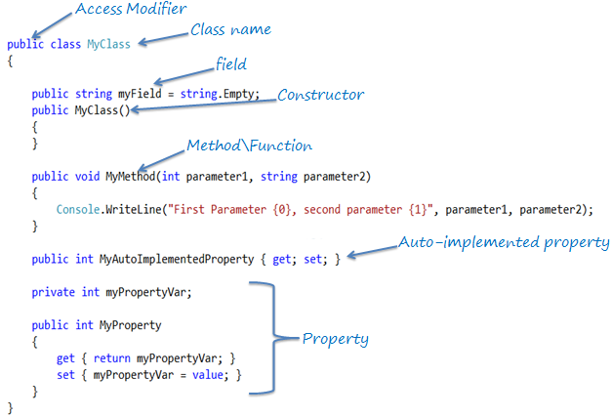

Slide 15
Objects
Any real time entity is known as an Object.
Every object consist of state and behavior.
States are called properties.
Behaviors are called methods.
It is an representor or instance of an object.

Slide 16
Encapsulation and Abstraction

Slide 17
Encapsulation
This binds the member function and data member into a single class.
This also allows for abstraction.
Within OOP, encapsulation can be achieved through creating classes.
Those classes then display public methods and properties.
Example,
Encapsulation is like an enclosing in a capsule, that is enclosing the related operation and data related to an object into that object.

Slide 18
Abstraction
Abstraction is important because it can hide unnecessary details from reference objects.
It is also necessary for the construction of programs.
Therefore, data abstraction is often used for managing large and complex programs.
Abstraction can be achieved by using Access Modifiers.

Slide 19
Access Modifiers
Access modifiers are applied on the declaration of the class and its members.
They define the accessibility of the class and its members.
Modifier | Description
public | There are no restrictions on accessing public members.
private | Access is limited to within the class definition. This is the default access modifier type if none is formally specified
protected | Access is limited to within the class definition and in inherited classes.
internal | Access is limited exclusively to classes defined within the current project assembly
protected internal | Access is limited to the current assembly and types derived from the containing class. All members in current project and all members in inherited classes.

Slide 20
Constructors

Slide 21
Constructors
Constructor is a special method, having the same name as the class/struct.
When an object of class or struct is created, its constructor is called.
They usually used to initialize the data members of the new object.
It won’t have any return type.
There are different types of constructors:
Default Constructor
Parameterized Constructor
Copy Constructor
Static Constructor and
Private Constructor

Slide 22
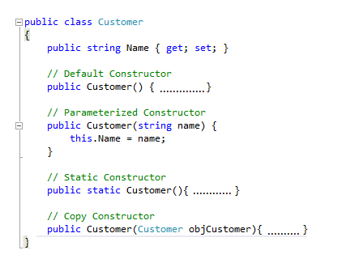

Slide 23
Default Constructor
Default constructor is automatically generated by the compiler in the absence of any programmer-defined constructors, and it don't have any parameter.
Many languages like C++, compiler don't generate any default constructor but user has to add one without any parameter.
Even in C# we can add a default constructor, in that case compiler will not generate any.

Slide 24
Parameterized Constructor
A parameterized constructor can have one or more parameters.
A class can have more than one paramerized constructors.
More than parameterized constructor should defer by function signatures as:
Number of parameters
Type of Parameters
Sequence of Parameters

Slide 25
Copy Constructor
A constructor accepting same type of object as parameter is Copy Constructor.
A class cannot have only copy constructor.
It need at least one more constructor to create the object.

Slide 26
Static Constructor
A static constructor is used to initialize the static member data.
It is used to perform some action only once in the beginning.
It is called implicitly before the first instance is created or any static members are referenced.
A static constructor does not take access modifiers or have parameters.
A class can only one static constructor
A class can have both instance and static construction in a single class
A static constructor cannot be called directly.

Slide 27
Private Constructor
In some cases we create a class which only have static members.
So, creating instance of this class is useless.
To prevent to create instance of class we use the private constructors.

Slide 28
Inheritance

Slide 29
Inheritance
In C#, Inheritance is used to inherit the properties from one class into class.
In C# inheritance, the class whose members are inherited is called base class.
In C#, a class can inherit one class at a time.
The class that inherits the members is called a derived class.
The inheritance helps in:
Reusability of Code
Reduce Time and Effort

Slide 30
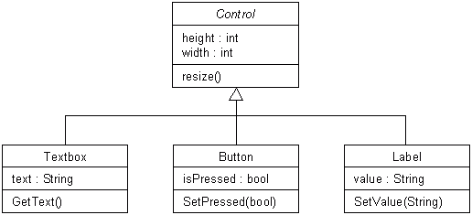
Inheritance Example

Slide 31
Types of Inheritance
OOPs support the six different types of inheritance as given below :
Single inheritance
Multi-level inheritance
Multiple inheritance
Multipath inheritance
Hierarchical Inheritance
Hybrid Inheritance

Slide 32
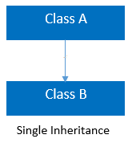
Single Inheritance
In this inheritance, a derived class is created from a single base class.

Slide 33
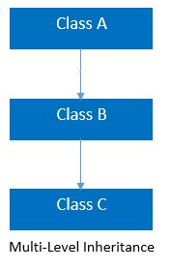
Multi-level Inheritance
In this inheritance, a derived class is created from another derived class.

Slide 34
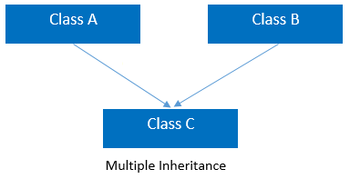
Multiple inheritance
In this inheritance, a derived class is created from more than one base class.
This inheritance is not supported by .NET and Java Language.

Slide 35
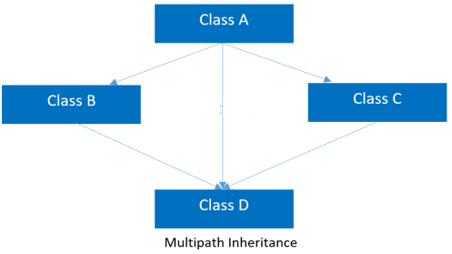
Multipath inheritance
In this inheritance, a derived class is created from another derived classes and the same base class of another derived classes.
This inheritance is not supported by .NET and Java Language.

Slide 36
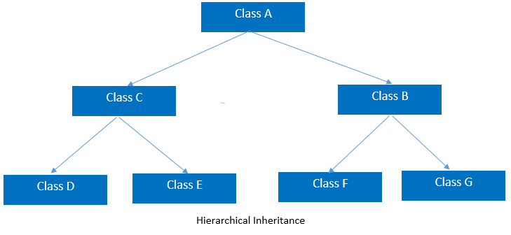
Hierarchical Inheritance
In this inheritance, more than one derived classes are created from single base class and further child classes act as parent classes for more than one child classes.

Slide 37
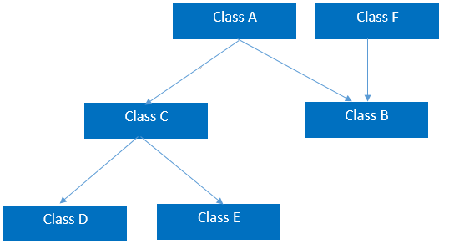
Hybrid Inheritance
This is combination of more than one inheritance.
Hence, it may be a combination of
Multilevel and Multiple inheritance or
Hierarchical and Multilevel inheritance or
Hierarchical and Multipath inheritance or
Hierarchical, Multilevel and Multiple inheritance.
This inheritance is not supported by .NET and Java Language.

Slide 38
Polymorphism

Slide 39
Polymorphism
Polymorphism is a feature of object-oriented programming.
Polymorphism means one name, many forms.
One function behaves in different forms.
In other words, "Many forms of a single object is called Polymorphism."
It allows you to invoke methods of a derived class during runtime.
It provides the different implementation of methods with the same name.

Slide 40
Types of Polymorphism
There are basically the following two types of polymorphism in C#:
Static / Compile Time Polymorphism.
Method Overloading
Constructor Overloading
Operator Overloading
Dynamic / Runtime Polymorphism.
Overriding using Virtual Methods
Overriding using Abstract Methods

Slide 41
Types of Polymorphism
Polymorphism
Static Polymorphism (Overloading)
Virtual Methods
Dynamic Polymorphism (Overriding)
Method Overloading
Operator Overloading
Abstract Methods

Slide 42
Overloading
Overloading is the mechanism to have more than one method with same name but with different signature (parameters).
A method can be overloaded on the basis of following properties
Have different number of parameter
Having same number of parameters but of different type
Having same number and type of parameters but in different orders
A method cannot be overloaded on the basis of
Different return type
Different access modifier
Normal and optional parameters

Slide 43
Overriding
Overriding can be done in derived class, an override method provides a new implementation of a method inherited from parent class.
To override a method in base (parent) class it must be
Virtual, abstract, override
We cannot override a base method which is in base class as
non-virtual and static
We cannot use the following modifiers to modify an override method in derived class
New, static, virtual, abstract

Slide 44
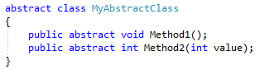
Abstract Methods
The purpose of an abstract class is to provide a common definition of base class.
Any class can be converted into abstract class by adding abstract modifier to it.
An abstract class cab be created by using abstract modifier

Slide 45
Abstract Methods
Common features of an abstract class:
An abstract class cannot be instantiated.
An abstract class can contain abstract as well as non-abstract methods.
An abstract method cannot have it implementation in abstract class itself.
An abstract class can never have a sealed modifier.
An abstract cannot be inherited from a class and multiple interfaces.
A property can also be abstract in an abstract class.
An abstract method can only be declared in an abstract class.
All derived classes must implement all the abstract methods in it.

Slide 46
Polymorphism: Points to be Noted:
Overloading can be done in same class.
Overriding can be done in parent and derived class.
Overloading in used when we need same method in same class with different parameters(using the different signature).
Overriding is used when we need to redefine a method that has already been defined in parent class (using the exact same signature).
Overloading is resolved at compile time.
Overriding is resolved at run time.

Slide 47
Interface

Slide 48
Interface
An Interface is a pure abstract class.
It is a reference type that contains only abstract methods. It only contains signature of its methods.
An interface has neither constructor nor fields.
It is also not permitted to have access modifier on its methods.
An interface can never be instantiated.
Its members are always implicitly public and abstract.
Its members cannot be declared as virtual or static.
We can implement multiple inheritance using Interface.

Slide 49
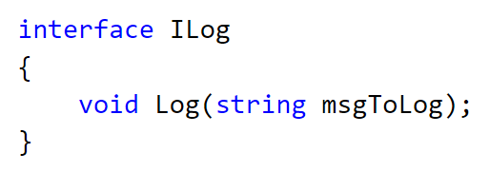
Interface
Interface Example:

Slide 50
Interface and Abstract Class
So to summarize,
For Interface:
Interface is used when you don't know anything about implementation but know the contract that implementer should have to accomplish the task.
For Abstract class:
Abstract class is used when you know partial implementation,
where say out of 5 methods, you know implementation of 3 methods and don't know implementation of 2 methods in that case 2 methods will be abstract and you need to rely on implementer as a contract to must provide body of abstract methods to accomplish the task.

Slide 51
Array in C#

Slide 52
Arrays
It is a user defined collection of homogenous data type elements.
We use index to access an element of an array.
When declaring an array, specify the type, name, dimensions and size.
In C# arrays are object and must be initialized, start with index zero (0),
C# supports:
Single-Dimensional Arrays,
Multidimensional Arrays (also call rectangular array) and
Array-of-Arrays (referred jagged arrays)

Slide 53
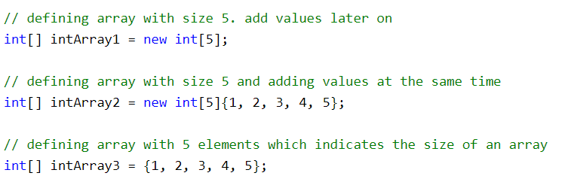
Arrays Initialization
An array can be declare using a type name followed by square brackets [].
An array can be declared and initialized at the same time using the new keyword.
The following example shows the way of initializing an array.

Slide 54
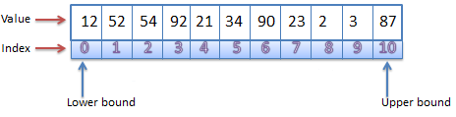
Single Dimensional Arrays
Arrays in C# are zero indexed.
An array with n elements is indexed from 0 to n-1.
Array elements can be of any type, including an array type as well.
Array types are reference types derived from the abstract base type Array.
We can use foreach iteration on all arrays in C#.

Slide 55
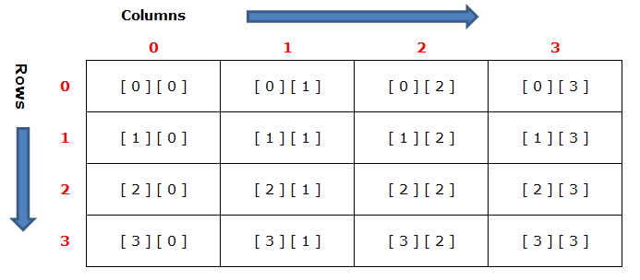
Multi-Dimensional Arrays
Two dimensional array is the simplest form of multi-dimensional array.
It can be thought as a table, which can contain number of rows and columns.

Slide 56
Jagged Arrays
It is also called array of array.
A jagged array is an array whose elements are also arrays.
The elements of a jagged array can be of different dimensions and sizes.
Before you can use jagged array, its elements must be initialized.
The element array can be of any length.

Slide 57
Exception Handling

Slide 58
Exception Handling
An application may encounter an error during the execution.
When an error occurs, either CLR or program code throws an exception.
Each exception contains necessary information about the error.
All the exception classes are derived from the Exception class.
There are two types of exceptions in .NET:
Exceptions generated by the executing program and
Exceptions generated by the CLR.

Slide 59
Exception Handling
There are two main classes for exceptions:
SystemException
SystemException is a base class for all CLR generated errors
ApplicationException.
ApplicationException serves as a base class for all application related exceptions, which you want to raise on business rule violation.

Slide 60
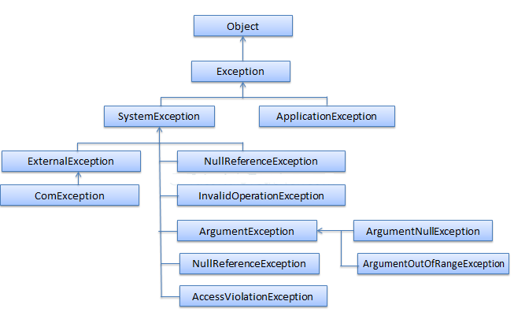
Exception Handling Hierarchy

Slide 61
Exception Handling
Every exception class in .NET is derived from the base Exception class.
It includes the following important properties using which you can use to get information about the exception when you handle the exception.
Property | Description
Message | Provides details about the cause of the exception.
StackTrace | Provides information about where the error occurred.
InnerException | Provides information about the series of exceptions that might have occurred.
HelpLink | This property can hold the help URL for a particular exception.
Data | This property can hold arbitrary data in key-value pairs.
TargetSite | Provides the name of the method where this exception was thrown.

Slide 62
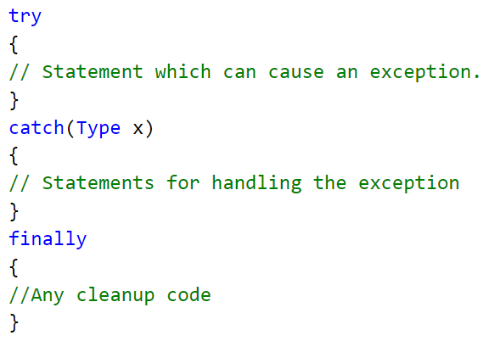
Exception Handling
There are three keywords try, catch and finally to implement exception handling.

Slide 63
C# Streams I/O

Slide 64
C# - Stream
C# includes following standard IO (Input/Output) classes to read/write from different sources like a file, memory, network, isolated storage, etc.
Stream
System.IO.Stream is an abstract class that provides standard methods to transfer bytes (read, write, etc.) to the source.
It is like a wrapper class to transfer bytes. Classes that need to read/write bytes from a particular source must implement the Stream class.

Slide 65
C# Streams
The following classes inherits Stream class to provide functionality to Read/Write bytes from a particular source:
FileStream reads or writes bytes from/to a physical file
MemoryStream: Reads or writes bytes that are stored in memory.
BufferedStream: Reads or writes bytes from other Streams to improve the performance of certain I/O operations.
NetworkStream: Reads or writes bytes from a network socket.
PipeStream: Reads or writes bytes from different processes.
CryptoStream: For linking data streams to cryptographic transformations.

Slide 66
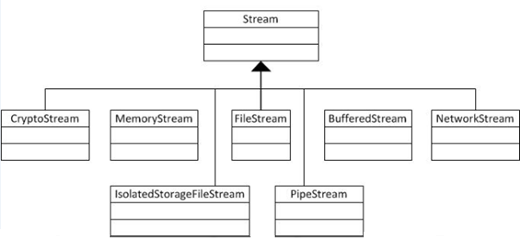
C# Streams
The following diagram shows the hierarchy of stream classes:

Slide 67
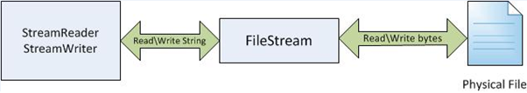
Stream Readers and Writers
StreamReader: StreamReader is a helper class for reading characters from a Stream by converting bytes into characters using an encoded value. StreamWriter: A helper class for writing a string to a Stream by converting characters into bytes.
BinaryReader: Aa helper class for reading primitive datatype from bytes.
BinaryWriter: Writes primitive types in binary.

Slide 68
File Handling

Slide 69
File Handling
C# provides the various classes to work with the File system.
They can be used to access directories, access files, open files for reading or writing, create a new file or move existing files from one location to another, etc.

Slide 70
C# - File
C# includes static File class to perform I/O operation on physical file system.
File is a static class to read\write from physical file with less coding.
Static File class provides functionalities such as create, read\write, copy, move, delete and others for physical files.
It is not recommended to use File class for multiple operations on multiple files at the same time due to performance reasons. Use FileInfo class in that scenario.

Slide 71
C# - FileInfo
The FileInfo class provides the same functionality as the static File class but you have more control on read/write operations on files by writing code manually for reading or writing bytes from a file.

Slide 72
Important Properties of FileInfo
Property | Usage
Directory | Gets an instance of the parent directory.
DirectoryName | Gets a string representing the directory's full path.
Exists | Gets a value indicating whether a file exists.
Extension | Gets the string representing the extension part of the file.
FullName | Gets the full path of the directory or file.
IsReadOnly | Gets or sets a value that determines if the current file is read only.
LastAccessTime | Gets or sets the time the current file or directory was last accessed
LastWriteTime | Gets or sets the time when the current file or directory was last written to
Length | Gets the size, in bytes, of the current file.
Name | Gets the name of the file.

Slide 73
Important Methods of FileInfo
Method | Usage
AppendText | Creates a StreamWriter that appends text to the file
CopyTo | Copies an existing file to a new file, disallowing the overwriting of an existing file.
Create | Creates a file.
CreateText | Creates a StreamWriter that writes a new text file.
Delete | Deletes the specified file.
MoveTo | Moves a specified file to a new location,
Open | Opens a in the specified FileMode.
OpenRead | Creates a read-only FileStream.
OpenWrite | Creates a write-only FileStream.
Replace | Replaces the contents of a specified file
ToString | Returns a path as string.

Slide 74
Properties

Slide 75
Properties
A property in C# is a member of a class.
It provides a flexible mechanism for classes to expose private fields.
Internally, properties are special methods called accessors.
A property have two accessors, get property accessor and set property accessor.
A get accessor returns a property value, and a set accessor assigns a new value.
The value keyword represents the value of a property.

Slide 76
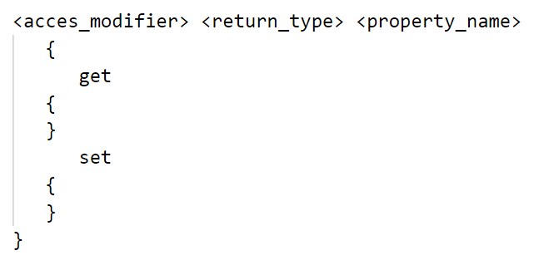
Properties
C# provides a built in mechanism called properties.
In C#, properties are defined using the property declaration syntax.
Where <access_modifier> can be private, public, protected or internal.
The <return_type> can be any valid C# type.

Slide 77
Static Properties
C# also supports static properties.
Static properties belong to the class rather than to the objects of the class.
All the rules applicable to a static member are applicable to static properties also.
The accessors of static property can access only other static members of the class.
Static properties are invoking by using the class name.

Slide 78
C# Collections

Slide 79
C# Collections
C# also includes specialized classes that hold many values or objects in a specific series, that are called 'collection'.
The System.Collections namespace includes the interfaces and classes for the non-generic collections.
There are two types of collections available in C#:
non-generic collections and
generic collections.

Slide 80
C# Collections
Non-generic Collections | Usage
ArrayList | ArrayList stores objects of any type like an array. However, there is no need to specify the size of the ArrayList like with an array as it grows automatically.
SortedList | SortedList stores key and value pairs. It automatically arranges elements in ascending order of key by default. C# includes both, generic and non-generic SortedList collection.
Stack | Stack stores the values in LIFO style (Last In First Out). It provides a Push() method to add a value and Pop() & Peek() methods to retrieve values. C# includes both, generic and non-generic Stack.
Queue | Queue stores the values in FIFO style (First In First Out). It keeps the order in which the values were added. It provides an Enqueue() method to add values and a Dequeue() method to retrieve values from the collection. C# includes generic and non-generic Queue.
Hashtable | Hashtable stores key and value pairs. It retrieves the values by comparing the hash value of the keys.
BitArray | BitArray manages a compact array of bit values, which are represented as Booleans, where true indicates that the bit is on (1) and false indicates the bit is off (0).

Slide 81
C# Generics

Slide 82
C# Generics
Generics allow you to define a class with placeholders.
They consist its fields, methods, parameters, etc.
Generics replace these placeholders with some specific type at compile time.
A generic class can be defined using angle brackets <>.
Compiler applies specified type for generics at compile time.
Generics can be applied to interface, abstract class, method, static method, property, event, delegate and operator.

Slide 83
C# Generics
Advantages of Generics
Increases the reusability of the code.
Generic are type safe. You get compile time errors if you try to use a different type of data than the one specified in the definition.
Generic has a performance advantage because it removes the possibilities of boxing and unboxing.

